Slide 1
NUCLEAR RNA POLYMERASES OF EUKARYOTIC CELLS
PRESENTED BY:
MAIDAH ASHFAQ
SUBMITTED TO:
DR.HUMERA MANZOOR

Slide 2
Nuclear RNA Polymerases Of Eukaryotic cells
Three distinctive nuclear RNA polymerases exist
in eukaryotic cells, each of which transcribes
different types of genes.
RNA polymerase I : It is a ribosomal RNA transcription enzyme.
The three major rRNA species, 28S, 18S, and 5.8S.

Slide 3
RNA Polymerase II:
This is a transcription enzyme that transcribes mRNA precursors.
In eukaryotic genomes, RNA polymerase II transcribes all protein-coding genes as well as numerous noncoding RNAs.
RNA Polymerase III:
RNA Polymerase III is an enzyme that transcribes tRNAs. It transcribes all rRNAs except the 5S rRNA component.

Slide 4
PROMOTERS AND TRANSCRIPTION FACTORS FOR RNA POLYMERASE II
A minimal RNA polymerase II (pol II) transcription system comprises the polymerase and five general transcription factors (GTFs) TFIIB, -D, -E, -F, and -H.
The GTFs are required for promoter recognition and the initiation of transcription.
This promoter consensus sequence is called the TATTA or Hogness box.
Because these sequences are on the same molecule of DNA as the gene being transcribed they are called cis- acting elements.

Slide 5
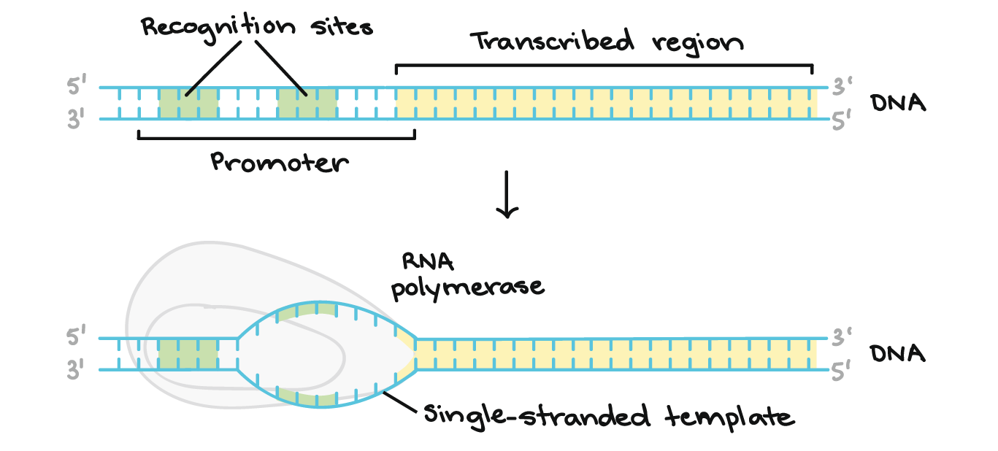

Slide 6
PROMOTERS AND TRANSCRIPTION FACTORS FOR RNA POLYMERASE II
Because these sequences are encoded by different genes, synthesized in cytosol, and must transit to their site of action, they are called trans-acting factors.
TFIID recognizes and binds the TATA box, and TFIIF brings the polymerase to the promoter.
TFs(transcriptional activators) bind to sequences within and outside of the core promoter.
In addition to binding DNA, specific TFs also bind other proteins.

Slide 7


